Slide 1
What is Cyclical SD? cyclicalsd.org
Our ongoing Presbytery initiative to support & start New Worshipping Communities (NWCs) in San Diego
Funded by SD Presbytery in 2017 with a $500,000 grant, budgeted through end of 2023
One of 15 Cyclical networks in the US/Canada/Europe aligned with:
Cyclical INC – cyclicalchurches.com
1001 New Worshipping Communities - newchurchnewway.org
faith·ful
adjective: remaining loyal and steadfast.
in·no·va·tion
noun: the action or process of making changes in something established, especially by introducing new methods, ideas, or products.

Slide 2
What does Cyclical SD do?
Cyclical San Diego is a faithful innovation ecosystem, investing in the holistic health of leaders. When leaders thrive, the communities in which they lead also thrive.
Support new “church planters” as they discern and work towards starting a New Worshipping Community
Provide a network for:
Spiritual coaching and training
Grants & achieving financial sustainability
Navigating administrative responsibilities, CRE process, how to charter, etc.
Discerners
Starters
Established

Slide 3
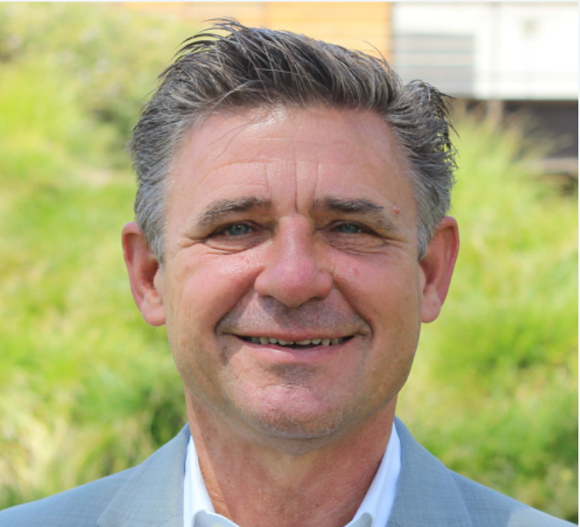
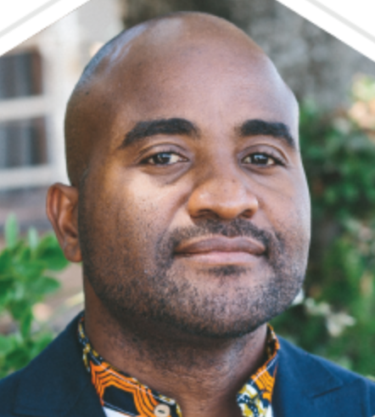
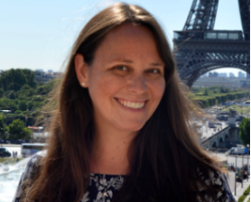
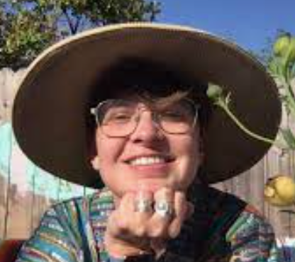
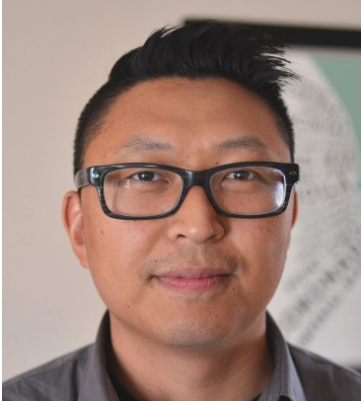
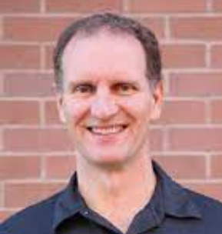
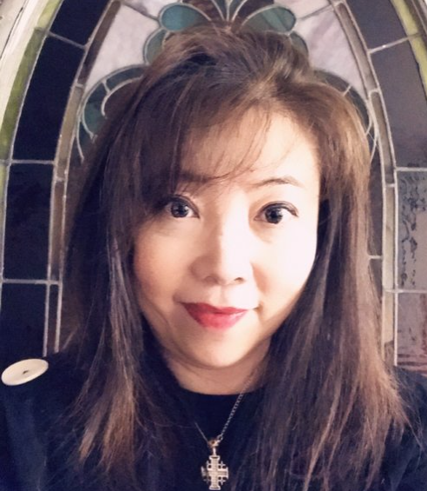
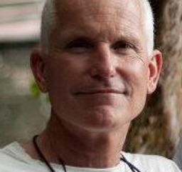
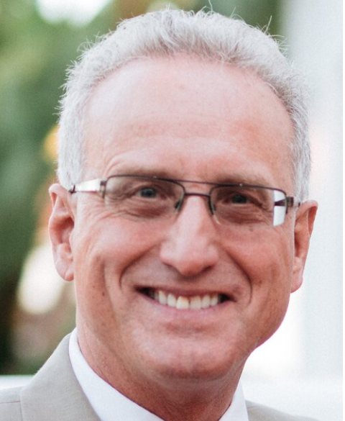
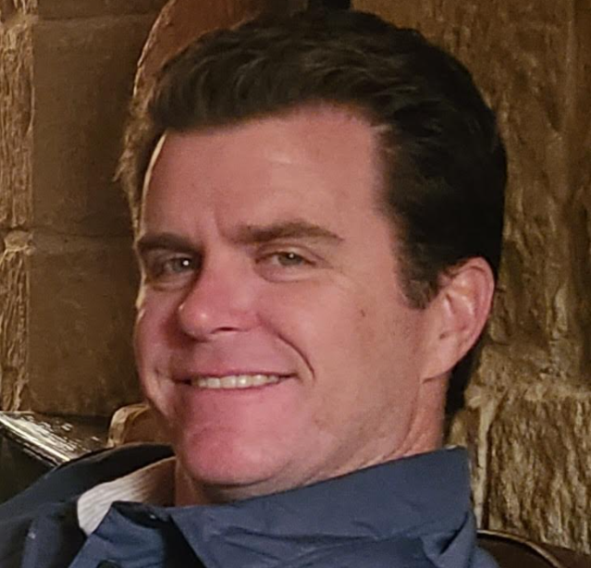
Cyclical SD Committee 2022
Rev. Mike McClenahan
Pastor – Solana Beach Presbyterian
Noel Musicha
Pastor – Ebenezer Church, Linda Vista
Rev. Eileen VanGieson
Associate Pastor - Christ Presbyterian Church
Rev. Megan Cochran
Pastor - Westminster Presbyterian Church (Point Loma)
Rev. Dr. Duncan McColl
Pastor - Mira Mesa Presbyterian Church
Rev. Chris Kohlbry
Pastor at large
Ex-Officio
Rev. Daniel So, Director of Cyclical SD
Pastor - Anchor City Church
Frances Lin
Stated Clerk
John Moser
Interim Executive Presbyter
Gresham Bayne (Chair 2022)
Ruling Elder, Point Loma Presbyterian Church

Slide 4
Stats at a glance -
Progress through the pandemic -
Multiple Faithful Innovation grants of up to $5,000 to different NWCs, with matching grant participation by the Synod of Southern California and Hawaii
Three grants awarded to NWCs in 2021 totaling $18,300 to support Shalom Initiatives like:
Community engagement and empowerment through neighborhood feasts with marginalized people
Supporting people experiencing homelessness to navigate towards their next stage of work
Research funding to help NWC discern the intersection of physician, spiritual, and emotional wholeness
Contributions toward the publication of Building a Garden of Churches

Slide 5
Cyclical needs your help…
Cyclical SD has made 10+ contacts with potential Discerners over the last 6 months
The next “church planter” in your community may already be sitting in your pew on Sundays!
Our top challenges are:
- Bringing awareness to the needs of individuals called to faithful innovation
- Helping these individuals find Cyclical
- Overcoming resistance to change
Email Daniel@cyclicalsd.org to share the Cyclical vision with your Session!

